Slide 1
Problem Formulation & EDA

Slide 2
A bit about myself
Work on travel insurance with the actuarial team at nib
Insurance premium modelling
Reserve modelling
Sales forecasts
Other ad-hoc issues
Have been trying to unpack what’s going on in data science for the past 3 years
Insert website here
Notes:
Other tasks include:
Financial reporting
These JD items if you will, seem very data science-ish.
More specifically, I have been trying to figure out what proportion of an data scientist = actuary

Slide 3
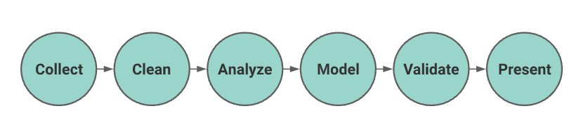
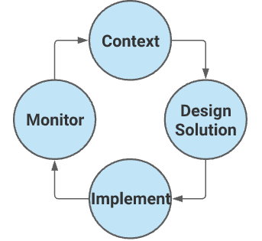
Background
Data science pipeline
Will not stray far from this in a google search
Why is it a linear process?
This is more like the Kaggle pipeline
Actuarial Control Cycle
At least this is circular/iterative
Quite vague
In actuarial exams, if you quoted this as an answer you’d fail instantly
Notes:
Here validate includes testing
Today, we’re going to talk about the defining and EDA steps.

Slide 4
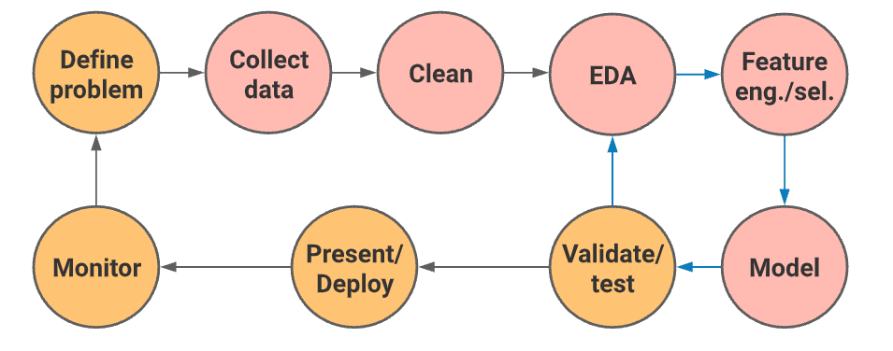
“My” pipeline
Ensemble model
Not all data science projects involve the red circles
Today’s presentation will focus on problem definition + EDA
No “right way” to do it, but there are best practices and frameworks

Slide 5
Problem formulation: Why bother?
Sometimes an incoming ticket/issue is not straightforward
Straightforward/not straightforward is actually a spectrum, not binary
High-level policy should always dictate low level implementation, not the other way around
Converting a business problem into a data problem
Notes:
If this step isn’t done, most of the time down the road what you are going to find is that low level details will start to drive your high-level decisions.
Personal journey, I used to be very impulsive when a new task/project came my way
Example:
I need to price a portfolio
Screw problem formulation
I open vscode, I take policy data, I take claims data, I left join
I take my favourite package sklearn, and chuck any regressor over it
If I am lucky my RMSE is reasonable

Slide 6
Defining the problem
There is no 1 fixed way to do this, but here is a general framework:
Clearly determining what the deliverable is for this problem. This will determine how far into the red part we actually get to.
If modelling required, determine what modelling problem it is, supervised/unsupervised/reg/classification/reinforcement/clustering (INSERT CHART LINK)
Write or review high-level data requirements
Write of review proposed KPIs to track
Decide on your tools/libraries
Notes:
Let’s be honest, not all data science problems involve a model. But for the purposes of this presentation let’s assume that they do.
Deliverables could be a set of prices, a dashboard, a word doc report of analyses on a certain issue, or a combination of these.
(3) May depend on the scale of the project, but it is
“The problem P. . .”: Here insert the problem as defined by the company.
“. . . has the impact I .” Insert the negative impacts/pain points of the problem.
“. . . which affects B. . .” Insert the parties that are affected. IT could be the business, the customers or a third party.
“…,so a good starting point would be S.” Insert the benefits of solving the problem.
Extend this not just to the results but interpretability requirements as well. What kind of statements do I need to be able to make at the end of the day?
Ideally not every step in problem formulation and EDA will directly feed into the decisions in the next, but as we will see later, some do.

Slide 7
Exploratory Data Analysis
Why bother?
Build intuition for the data
Inform model selection and feature selection
Identify patterns and develop hypothesis
Cover your ass (it’s a form of documentation)
Challenge assumptions
Answer questions you didn’t have (bonus)
4 mental buckets
Outliers and scaling
Class imbalance and sus results
Oh definitely need to include this ( or some combination)
Oh definitely exclude this
Notes:
Even if you are dealing with the same dataset, a different problem will force a new perspective on it.
Here, we open the old aiforsea project and go through an example of how useful EDA is for a future reference.
For heavy excel users, think of it this way. Doing up a model without any EDA is like doing all the spreadsheet workings, then copy pasting as values and saving over it.
The idea is go through and iterate through the EDA process, and throw the feature columns into one of these buckets along the way.

Slide 8
Example: Travel insurance dataset
Target: Claim Status
Name of agency
Type of travel insurance agencies
Distribution channel of travel insurance agencies
Name of the travel insurance products
Duration of travel
Destination of travel
Amount of sales of travel insurance policies
Commission received for travel insurance agency
Gender of insured
Age of insured
Notes:
Of course a DS brownbag will not be DS brownbag without an example

Slide 9
TO THE NOTEBOOK

Slide 10
Outliers and scaling
Can be determined from either .describe() or scatter matrices
Do we need it?
Which algorithm should we use, and do we need to scale our data? (technically yes, it is always good practice)
How do we want to scale our data?
Notes:
Normalization helps to eliminate scale factors that might exist between variables in your data. Take, for example, the classic problem of predicting home prices. If you represent the square footage of your home in square millimeters, a large change in this value will have a relatively small effect on home price, implying a small gradient on this variable. If you represent that value in square kilometers, a small numerical change will have a large impact on price, implying a large gradient. Normalization isn't necessarily required, but can help to balance the problem by making all variables have "equal weight" in your model. If you were to include both the square millimeter and square kilometer variables in your training data, the neural network would likely spend a lot of effort optimizing on the square kilometer variable, since it is numerically more important. You can still do training with un-normalized data, but it will likely take longer, and possibly have worse output if your important variables are numerically smallest.
the l1 and l2 regularizers of linear models) assume that all features are centered around zero and have variance in the same order. If a feature has a variance that is orders of magnitude larger than others, it might dominate the objective function and make the estimator unable to learn from other features correctly as expected.
Generally, in tree-based models the scale of the features does not matter. This is because at each tree level, the score of a possible split will be equal whether the respective feature has been scaled or not.
You can think of it like here: We're dealing with a binary classification problem and the feature we're splitting takes values from 0 to 1000. If you split it on 300, the samples <300 belong 90% to one category while those >300 belong 30% to one category. Now imaging this feature is scaled between 0 and 1. Again, if you split on 0.3, the sample <0.3 belong 90% to one category while those >0.3 belong 30% to one category.
So you've changed the splitting point but the actual distribution of the samples remains the same regarding the target variable.
There are two main reasons to use logarithmic scales in charts and graphs. The first is to respond to skewness towards large values; i.e., cases in which one or a few points are much larger than the bulk of the data. The second is to show percent change or multiplicative factors.

Slide 11
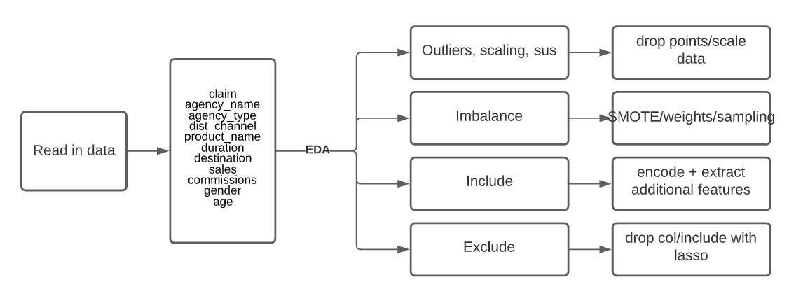
EDA Summary

Slide 12
Summary
??
Define problem -> collect -> clean -> EDA -> feature engineer -> model -> validate/test -> present -> monitor
Level of interpretability
KPI thresholds

